Slide 1
Gender and Local Politics
By Dan Nataf, Ph.D.
Director, Center for the Study of Local Issues
Professor, Political Science
Anne Arundel Community College
www2.aacc.edu/csli
ddnataf@aacc.edu
410-777-2733
October 30, 23018

Slide 2
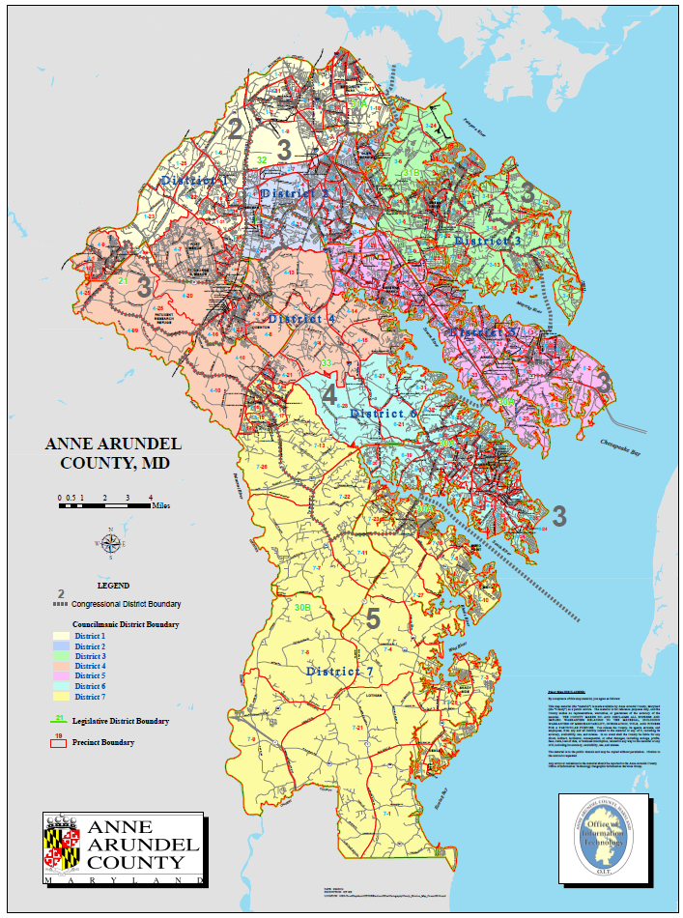
AA County: History of Women Elected to Office (1986- present)
County Council:
Democrats – Pam Beidle (Dist. 1), Shirley Murphy (Dist. 3), Carole Baker (Dist. 5) Maureen Lamb (Dist. 6), Barbara Maxwell (Samorajczyk) (Dist. 6), Virginia Claggett (Dist. 7), (N=6)
Republicans – Diane Evans (Dist. 5), Cathy Vitale (Dist. 5) (N= 2)
Delegates:
Democrats – Virginia Clagett (Dist. 30), Mary Rosso (Dist. 31), Joan Cadden (Dist. 31) Mary Ann Love (Dist. 32), Pam Beidle (Dist. 32), (N= 5)
Republicans – Megan Simonaire (Dist.31), Victoria Schade (Dist. 31), Janet Greenip (Dist.33), Elizabeth Smith (Dist. 33) Cathy Vitale (Dist.33), (N= 5)
Senators:
Democrats – None Republicans – Janet Greenip
County Executive: Democrats – Janet Owens; Republicans* – None
Mayor Annapolis: Democrats - Ellen Moyer; Republicans* – None
Sherriff – None; State’s Attorney* – None; Clerk of Court – None
Register of Wills – Democrats, none; Republicans, Lauren Parker
*=appointed (CE - Laura Neuman, SA - Anne Colt Leitess)
1
2
3
4
5
6
7

Slide 3
Gender and Candidates: 2018 General Election
Women majority

Slide 4
Candidates by Gender, Party and Office
Majority of Dem delegate candidates are women
Majority of Dem council candidates are women

Slide 5
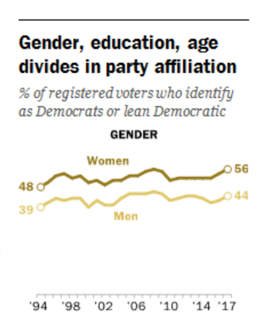
Gender: Voters and Parties
http://www.people-press.org/2018/03/20/wide-gender-gap-growing-educational-divide-in-voters-party-identification/
Residual percentages are “other” party.

Slide 6
Gender, Party and Most Important Problem

Slide 7
Gender/Party and Perceptions of Discrimination
Biggest Gaps Clinton vs. Women: White men, Native-Americans, Women, African-Americans
Partisan Differences Eclipse Gender Differences

Slide 8
Gender and Issues: Openness to Diversity…

Slide 9
Gender and Issues: Environment
Women more pro-environment, than men, but Clinton voters much more extreme.

Slide 10
Gender and Public Safety/Gun Control/Schools

Slide 11
Gender and Economic Issues

Slide 12
Gender and Vote for Candidates

Slide 13
Gender/Party/Votes by Ideology

Slide 14
Conclusions
Women more liberal than men – on environment, schools, taxation, economy, perceptions of discrimination, education
Women less liberal than Democrats (Clinton voters) – on immigration, environment, perception of crime/drugs as problem
Women have some areas of greater/lesser agreement with Democrats – some social issues, perceptions of discrimination, some school safety
Democrats cannot assume a homogeneous “women’s” vote – there are as many conservative as liberal women
Men are the heart of Republican coalition
Men are much more conservative than liberal – probusiness, anti-tax, anti-regulation, pro-growth/development (seen as less of a problem)
Women candidates can come from either party – but more likely to gain support from other women by espousing center/left Democratic stances

